Slide 1



Design Principles
Technology & Process for Growth
Design Principles
Presenters
Madhu Babu Karanam

Slide 2
SOLID principles
S – Single Responsibility Principle
O – Open / Closed Principle
L – Liskov Substitution Principle
I – Interface Segmented Principle
D – Dependency Inversion Principle
Others:
Don’t repeat yourself
Keep it Simple
Advantages
Avoid duplicate code
Easy to maintain
Easy to understand
Flexible software
Reduce complexity

Slide 3
Single Responsibility Principle
A Class should have only 1 reason to change
public class Book { private String name; private String author; private String text; //constructor, getters and setters // methods that directly relate to the book properties public String replaceWordInText(String word, String replacementWord){ return text.replaceAll(word, replacementWord); } public boolean isWordInText(String word){ return text.contains(word); } }
public class Book { //... void printTextToConsole(){ // our code for formatting and printing the text } }

Slide 4
Single Responsibility Principle
public class BookPrinter {
// methods for outputting text void printTextToConsole(Book book){ //our code for formatting and printing the text } void printTextToAnotherMedium(Book book){ // code for writing to any other location.. } }
public class BookDAO { // method for saving to db void saveBookToDB(Book book){ //our code for saving to db } // method for saving to file void saveBookToFile(Book book){ // code for saving to file.. } }

Slide 5
Single Responsibility Principle
public class BookPrinter {
// methods for outputting text void printTextToConsole(Book book){ //our code for formatting and printing the text } void printTextToAnotherMedium(Book book){ // code for writing to any other location.. } }
public class BookDAO { // methods for outputting text void saveBookToDB(Book book){ //our code saving to db }
}

Slide 6
Open / Closed Principle
Class should be Open for Extension but closed for Modification
public class BookDAO { void saveBookToDB(Book book){ //Save to DB }
/* void saveBookToFile(Book book){ // Save to File
} */ }

Slide 7
Open / Closed Principle
Open for Extension but closed for Modification
public interface BookDAO { public void save(Book book); }
public class BookDBDAO implements BookDAO{ public void save(Book book){ // Save to DB } }
public class BookFileDAO implements BookDAO{ public void save(Book book){ // Save to File } }

Slide 8
Liskov Substitution Principle
If Class B is subtype of Class A, then we should be able to replace object of A with B without breaking the behavior of the program
Sublclass should not narrow down functionality of Parent class
public interface Byke { void startEngine(); void accelerate(); }
public class MotorCycle implements Byke{ @Override public void startEngine() { System.out.println("MotorCycle engine started"); } @Override public void accelerate() { System.out.println("MotorCycle speed increased"); } }
public class Cycle implements Byke{ @Override public void startEngine() { throw new AssertionError("There is no cycle engine"); } @Override public void accelerate() { System.out.println("Cycle speed increased"); } }

Slide 9
Liskov Substitution Principle
If Class B is subtype of Class A, then we should be able to replace object of A with B without breaking the behavior of the program
public interface Byke { void accelerate(); }
public class Cycle implements Byke { @Override public void accelerate() { System.out.println("Cycle speed increased"); } }
public class MotorCycle implements Byke { @Override public void accelerate() { System.out.println("MotorCycle speed increased"); } public void startEngine() { System.out.println("MotorCycle engine started"); } }
public class BykeStarter { void rideByke(Byke byke){ //byke.startEngine(); byke.accelerate(); } public static void main(String[] args) { BykeStarter starter = new BykeStarter(); MotorCycle motorCycle = new MotorCycle(); motorCycle.startEngine(); starter.rideByke(motorCycle); starter.rideByke(new Cycle()); } }

Slide 10
Interface Segregation Principle
Interfaces should be such that client should not implement unnecessary functions they do not need
public interface RestaurantEmployee { void washDishes(); void serveCustomers(); void cookFood(); }
public class Waiter implements RestaurantEmployee{ @Override public void washDishes() { System.out.println("i dont wash dishes"); } @Override public void serveCustomers() { System.out.println(" Serve Customers"); } @Override public void cookFood() { System.out.println("I dont cook food"); } }

Slide 11
Interface Segregation Principle
Interfaces should be such that client should not implement unnecessary functions they do not need
public interface WaiterIntferface { void serveCustomers(); void TakeOrders(); }
public interface ChefIntferface { void cookFood(); void decideMenu(); }
public class Waiter implements WaiterIntferface{ @Override public void serveCustomers() { } @Override public void TakeOrders() { } }

Slide 12
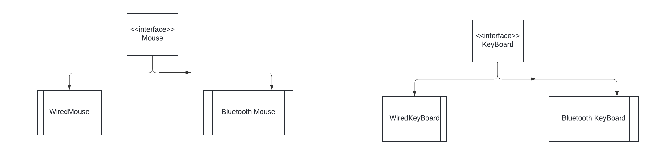
Dependency Inversion Principle
Classes should depend on Interfaces rather than concrete classes

Slide 13
Dependency Inversion Principle
Classes should depend on Interfaces rather than concrete classes
public class MackBook { private final WiredMouse wiredMouse; private final WiredKeyBoard wiredKeyBoard; public MackBook(){ wiredMouse = new WiredMouse(); wiredKeyBoard = new WiredKeyBoard(); } }
Correct Way
public class MackBook { private final Mouse mouse; private final KeyBoard keyBoard; public MackBook(Mouse mouse,KeyBoard keyBoard){ this.mouse = mouse; this.keyBoard = keyBoard; } }

